Slide 1



ENIVRONMENT SENSORS
ENIVRONMENT SENSORS

Slide 2

1
Temperature Sensors
Agenda
2
Humidity Sensors
Topics Covered
3
Pressure Sensors
4
Gas Sensors

Slide 3

Environmental Sensors: The Foundation
Definition: Devices that detect and measure physical or chemical properties of the environment and convert them into electrical signals.
IoT Integration: Sensors are the "eyes and ears" of the Internet of Things, providing the data stream necessary for automation, monitoring, and decision-making.
Key Applications: Smart Homes (HVAC, air quality), Industrial Monitoring (predictive maintenance), Agriculture (soil/weather), and Environmental Science (pollution tracking).
Four Core Parameters: Temperature, Humidity, Pressure, and Gas concentration

Slide 4
Temperature Sensors: Monitoring Heat Levels
Principle: Temperature sensors detect changes in physical properties like resistance, voltage, or digital signals due to heat variations.
Types:
1-Wire Digital — Single-wire protocol for easy multi-sensor chaining.
I2C/SPI Digital — High-precision digital interfaces, often multi-parameter.
Single-Bus Digital — Custom protocol (e.g., for DHT series).
Analog — Voltage output requiring ADC.
Key Specifications (General):
Range: Typically -55°C to +125°C.
Accuracy: ±0.5°C to ±2°C (varies by model).
Resolution: 0.0625°C to 0.5°C.
Power: 3.3V–5V, low consumption (μA to mA).
Response Time: 1–10 seconds.
Interface: 1-Wire, I2C, SPI, or single-bus.
Examples :
DS18B20 — Digital 1-Wire sensor, excellent for multi-point or outdoor use (waterproof versions available).
DHT22 (AM2302) — Combined temp/humidity, affordable and popular for indoor projects.

Slide 5
EXAMPLES
DS18B20 — Digital 1-Wire temperature sensor with waterproof options, ideal for multi-point or outdoor monitoring (-55°C to +125°C, ±0.5°C accuracy).
DHT11 — Basic low-cost digital temperature and humidity sensor for simple indoor projects (0°C to 50°C, ±2°C accuracy).
DHT22 / AM2302 — Accurate digital temperature and humidity sensor, popular for weather stations (-40°C to +80°C, ±0.5°C accuracy).
TMP117 — High-precision I2C temperature sensor from Texas Instruments (±0.1°C accuracy over wide range).
MCP9808 — Precise I2C digital temperature sensor with high resolution (up to 0.0625°C).
LM75 — Simple I2C digital temperature sensor, reliable for basic monitoring (-55°C to +125°C).
PT100/PT1000 — Resistance-based RTD sensors requiring amplifier module for high-accuracy industrial use.
TMP36 — Analog voltage-output temperature sensor, affordable but needs ADC on Pi.

Slide 6
DHT22 (AM2302) Sensor
Key Specifications:
Temperature Range: -40°C to +80°C
Temperature Accuracy: ±0.5°C (typical)
Temperature Resolution: 0.1°C
Humidity Range: 0% to 100% RH
Humidity Accuracy: ±2% RH (at 25°C; up to ±5% at extremes)
Humidity Resolution: 0.1% RH
Sampling Rate: Maximum 1 reading every 2 seconds (recommended every 5–10s for stability)
Operating Voltage: 3.3V to 5.5V (works perfectly with Raspberry Pi's 3.3V)
Current Consumption: ~1–1.5mA during measurement, ~60μA standby
Interface: Single-bus digital (one data wire for communication)
Response Time: ~2 seconds for humidity, ~30 seconds for temperature stabilization
Long-term Stability: Good, but avoid prolonged exposure to >90% RH or condensing environments
It's more accurate and has a wider range than the cheaper DHT11.

Slide 7
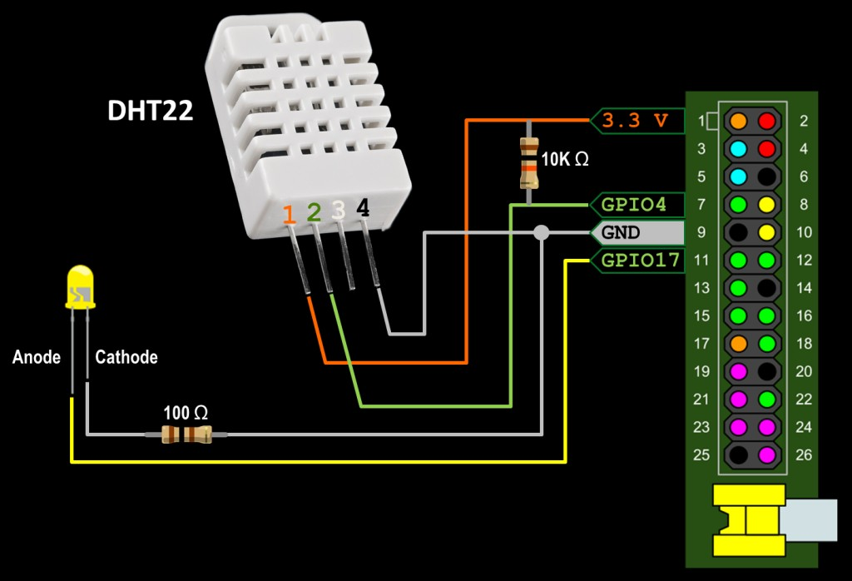
Principle:
The DHT22 uses a single data pin to send a 40-bit digital packet (16 bits humidity + 16 bits temperature + 8 bits checksum) in response to a start signal from the host (Raspberry Pi), with timing-based bit encoding (high/low pulse durations distinguish 0s and 1s).
Connections to Raspberry Pi:
The DHT22 typically comes in two forms: bare sensor (4 pins) or breakout module (often 3–4 pins with built-in pull-up).
Standard 4-pin configuration (left to right, facing the grille):
VCC (power: connect to 3.3V or 5V on Pi)
Data (signal: connect to any GPIO pin, e.g., GPIO 4)
NC (not connected: leave floating)
GND (ground: connect to GND on Pi)
Important:
Add a 4.7kΩ to 10kΩ pull-up resistor between VCC and Data pin (many modules have it built-in; if not, add externally for reliable communication)
DHT22 Tutorial for Raspberry Pi

Slide 8
TMP36 Sensor
The TMP36 is a low-cost, precision analog temperature sensor from Analog Devices that outputs a voltage linearly proportional to the temperature in Celsius (°C). It requires no external calibration and is ideal for simple analog projects, but since Raspberry Pi has no built-in analog inputs, it needs an external ADC like the popular MCP3008 (10-bit SPI ADC).
Key Specifications
Temperature Range: -40°C to +125°C
Accuracy: ±1°C typical at 25°C, ±2°C over full range (typical)
Linearity: ±0.5°C typical
Scale Factor: 10 mV/°C
Output Voltage at 25°C: 750 mV
Offset: 500 mV (output = 750 mV at 25°C, formula: Temp °C = (Vout in mV - 500) / 10)
Operating Voltage: 2.7V to 5.5V
Current Consumption: <50 μA (very low self-heating <0.1°C in still air)
Output Type: Analog voltage (0.1V to ~1.75V typical range)
Response Time: Depends on thermal mass, typically seconds
Package: TO-92 (3-pin transistor-like), SOT-23, or SOIC
It's more precise and wider-range than basic thermistors, with built-in Celsius scaling.

Slide 9
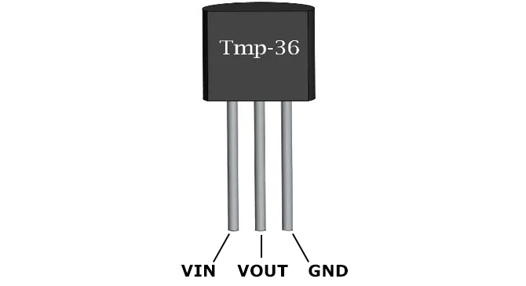
Connections to Raspberry Pi
The TMP36 is a 3-pin device (flat side facing you: left to right).
Pin Configuration (TO-92 package, flat side facing you):
Vs (+ power: connect to 3.3V or 5V on Pi)
Vout (analog output: connect to ADC input channel, e.g., CH0 on MCP3008)
GND (ground: connect to GND on Pi)
Raspberry Pi cannot read analog directly
→ use an external ADC like MCP3008 (SPI interface).
Typical setup: TMP36 Vout
→ MCP3008 CH0; MCP3008 connected to Pi SPI pins (MOSI, MISO, SCLK, CE0) + power/GND.
Power TMP36 from 3.3V for safety (output max ~1.75V < Pi's 3.3V tolerance).
No pull-up needed; add decoupling capacitor (0.1μF) between Vs and GND for stability if noisy.
TMP36 Precision Temperature Sensor

Slide 10
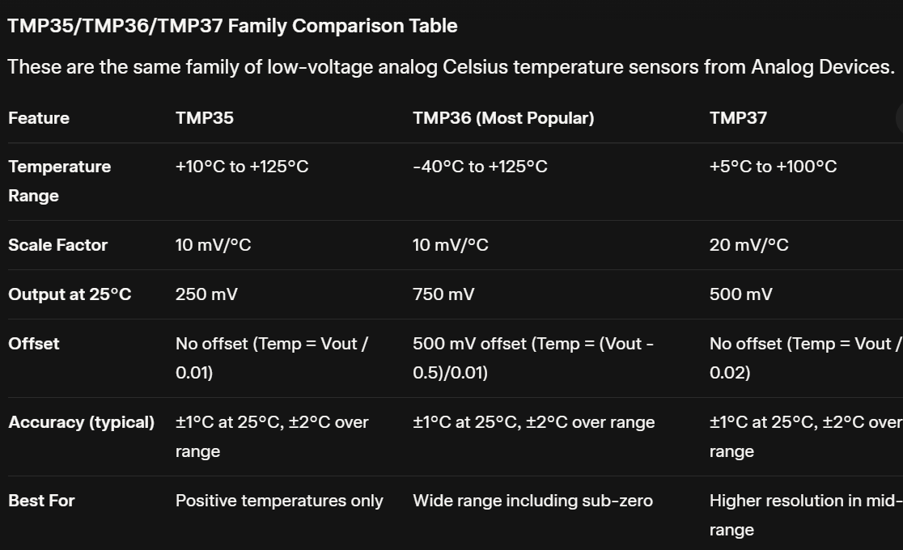

Slide 11
PT100/PT1000 (RTD) Sensor
PT100 and PT1000 are platinum Resistance Temperature Detectors (RTDs)—high-precision temperature sensors where resistance changes linearly with temperature (platinum's resistance increases predictably with heat). They require an amplifier/converter module (e.g., MAX31865) for Raspberry Pi use, as the Pi can't measure resistance directly.
Key Specifications (PT100)
Resistance at 0°C: 100 Ω
Temperature Coefficient: 0.00385 Ω/°C (TCR; Class A/B standard)
Temperature Range: Typically -200°C to +850°C (probe-dependent)
Accuracy: ±0.15°C to ±0.3°C (Class A typical)
Linearity: Excellent over wide range
Response Time: 0.5–10 seconds (probe-dependent)
Wiring Configurations: 2-wire (simple, less accurate), 3-wire (common, compensates lead resistance), 4-wire (highest accuracy)
Operating Current: Low (1–5mA) to minimize self-heating

Slide 12
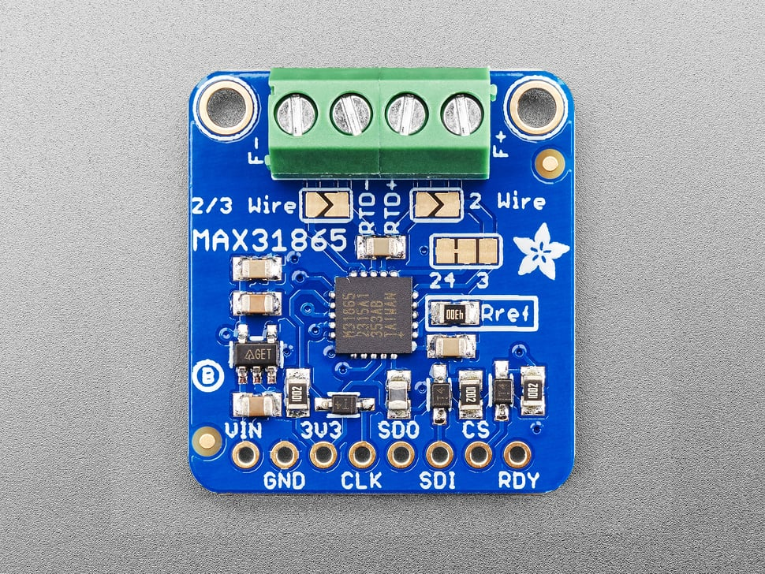
Connections to Raspberry Pi
RTDs connect to a breakout amplifier (most popular: Adafruit/SparkFun MAX31865 module, supports PT100 & PT1000).
Typical Setup:
RTD probe wires → MAX31865 terminals (2/3/4-wire).
MAX31865 → Raspberry Pi via SPI:
VIN → 3.3V
GND → GND
SCLK → GPIO 11 (SCLK)
MOSI → GPIO 10 (MOSI)
MISO → GPIO 9 (MISO)
CS → Any GPIO (e.g., GPIO 8)
Optional: 3.3V reference for PT1000

Slide 13
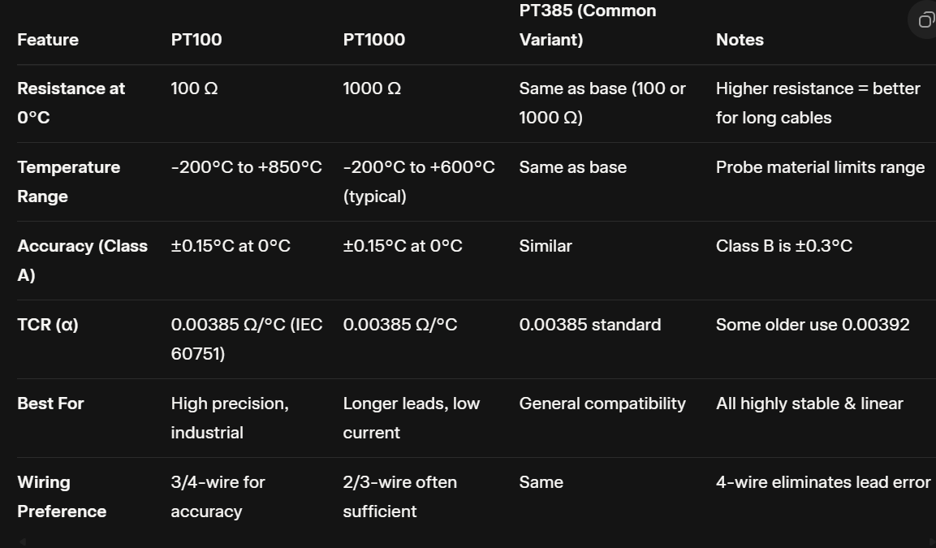

Slide 14
Humidity Sensors: Monitoring Moisture Content
Principle: Sensors measure water vapor in air (Relative Humidity - RH%) via changes in capacitance (most common), resistance, or other properties of moisture-sensitive materials.
Types:
Capacitive — Stable and precise, polymer-based dielectric change.
Resistive — Resistance varies with humidity.
Integrated Digital — Often combined with temperature.
Key Specifications (General):
RH Range: 0–100%.
Accuracy: ±2% to ±5% RH.
Resolution: 0.1% to 1% RH.
Power: 3.3V–5V, low power.
Response Time: 5–30 seconds.
Interface: Digital (I2C or single-bus).
Examples for Raspberry Pi:
DHT22 (AM2302) — Low-cost digital sensor with good balance of price and performance.
AHT20 — Compact I2C sensor, high stability.
SHT31 — High-precision from Sensirion.

Slide 15
AHT20 / AHT21 — Compact I2C temperature and humidity sensor with good precision (±2% RH, ±0.3°C).
SHT40 / SHT45 — High-precision Sensirion I2C sensors, excellent for accurate environmental monitoring (±1.8% RH typical).
SHT31 / SHT30 — Reliable Sensirion I2C temperature/humidity sensors with strong long-term stability (±2% RH).
SHT15 — Older breakout-style Sensirion sensor, still used for precise humidity in legacy projects.
HIH-4030 — Analog humidity sensor from Honeywell, requires ADC for integration.
AM2320 — I2C digital temperature and humidity sensor, similar to DHT but more stable.
HTU21D — Compact I2C humidity and temperature sensor, good for embedded applications.
SHTC3 — Low-power Sensirion I2C sensor for precise temperature and humidity in small projects.

Slide 16
SHT40 / SHT45 (Sensirion SHT4x Series) Sensor
The SHT4x series from Sensirion is the fourth-generation family of high-precision digital temperature and humidity sensors, built on an optimized CMOSens® chip. The SHT40 is the standard high-accuracy model, while the SHT45 is the ultra-high-precision flagship. All models use a true I2C interface, making them extremely easy to connect to Raspberry Pi—no single-bus timing issues like DHT sensors.
Key Specifications (Common to Series)
Humidity Range: 0% to 100% RH
Temperature Range: -40°C to +125°C
Supply Voltage: 1.08V to 3.6V (perfect for 3.3V Raspberry Pi)
Average Current: ~400 nA (ultra-low power, ideal for battery projects)
Interface: I2C (addresses usually 0x44; some variants 0x45)
Built-in Heater: For self-dehumidification/condensation protection
Response Time: <8s (humidity), <2s (temperature)
Package: Tiny DFN (often on breakout boards like Adafruit STEMMA QT)
Model-Specific Accuracy (Typical):
SHT40: ±1.8% RH / ±0.2°C
SHT45: ±1.0% RH / ±0.1°C

Slide 17
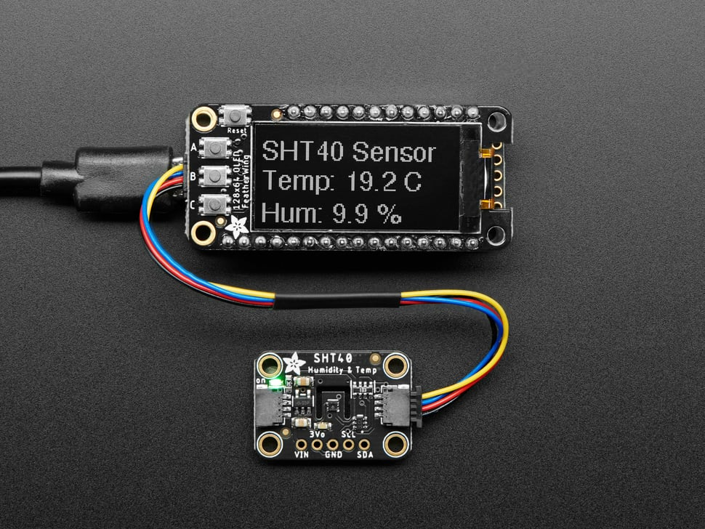
Connections to Raspberry Pi
All SHT4x models (including SHT40/SHT45) have identical pinouts on breakout boards (e.g., Adafruit or generic).
Standard 4-pin Breakout (e.g., STEMMA QT / Qwiic):
VDD / VIN → 3.3V on Pi
GND → GND on Pi
SCL → GPIO 3 (SCL, Pin 5)
SDA → GPIO 2 (SDA, Pin 3)
Adafruit Sensirion SHT40 Temperature & Humidity Sensor

Slide 18
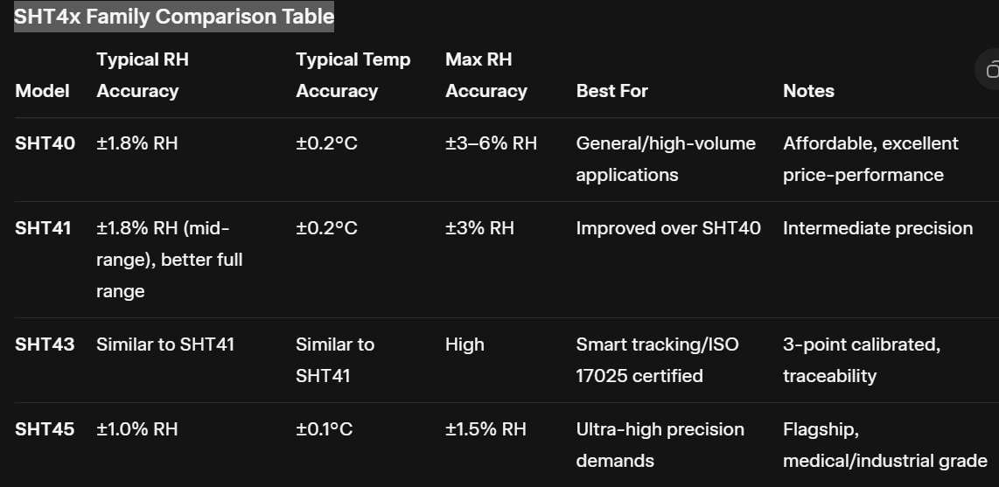

Slide 19
HIH-4030 (Analog) Sensor
The HIH-4030 is a Honeywell analog relative humidity sensor from the HIH-4000/4030 series, designed for high-volume OEM use. It outputs a near-linear analog voltage proportional to relative humidity (RH) and requires temperature compensation for accurate readings. Since it's analog, Raspberry Pi needs an external ADC (e.g., MCP3008) to read it.
Key Specifications
Humidity Range: 0% to 100% RH (non-condensing recommended)
Humidity Accuracy: ±3.5% RH typical
Output: Near-linear analog voltage (~3.27V at 0% RH to ~0.87V at 100% RH at 5V supply and 25°C; formula: True RH = (Sensor RH / (0.0062 * Vsupply - 0.16)) * (1 + temp compensation)
Supply Voltage: 4V to 5.8V (optimally 5V)
Current Consumption: ~200 μA typical
Response Time: 5 seconds in slow-moving air
Operating Temperature: -40°C to +85°C
Output Type: Analog voltage
Package: SMD (surface-mount) or breakout board

Slide 20
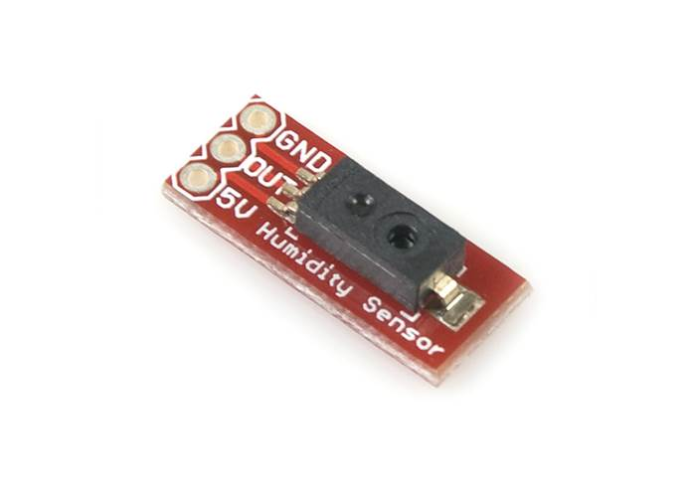
Connections to Raspberry Pi
Commonly available as a 3-pin breakout board (e.g., SparkFun/Pololu carrier).
Standard 3-pin Breakout Configuration:
5V / VCC → 5V on Pi (or external 5V source)
GND → GND on Pi
OUT (analog output) → ADC input channel (e.g., CH0 on MCP3008)
HIH-4030 Humidity Sensor Carrier - Robot Gear Australia

Slide 21
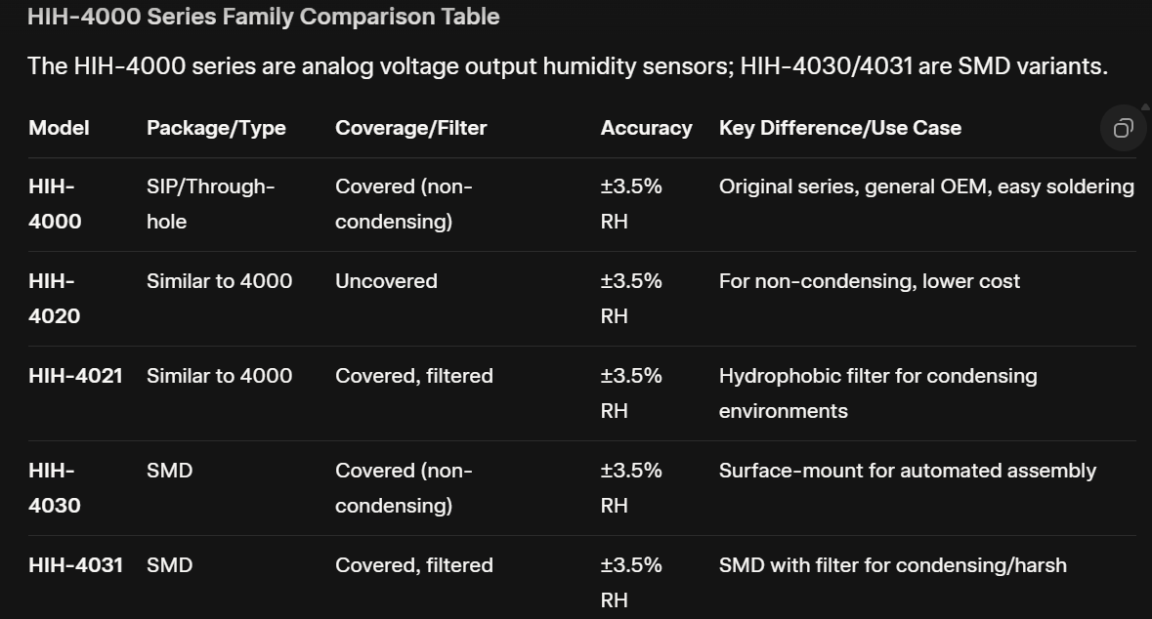

Slide 22
Pressure Sensors: Monitoring Atmospheric Pressure
Principle: Detect air pressure via membrane deformation (piezoresistive or capacitive), often used for altitude calculation or weather forecasting.
Types:
MEMS Absolute — Measures vs. vacuum, digital output.
Combined — Bundled with temperature (and sometimes humidity).
Key Specifications (General):
Pressure Range: 300–1100 hPa (or wider in newer models).
Accuracy: ±0.5 to ±1 hPa.
Resolution: 0.01–0.1 hPa.
Altitude Accuracy: ~1 meter.
Power: 3.3V, ultra-low current.
Interface: I2C or SPI.
Examples for Raspberry Pi:
BMP280 — Affordable I2C/SPI sensor, includes temperature.
BME280 — Adds humidity to BMP280.

Slide 23
Pressure Sensors (barometric, often with temp/humidity)
BMP280 — Affordable Bosch I2C/SPI sensor for pressure and temperature, great for altitude calculation.
BME280 — Bosch multi-sensor adding humidity to BMP280 for full environmental data.
BMP180 — Older Bosch I2C pressure/temperature sensor, still common in basic weather projects.
BMP388 / BMP390 — Newer high-precision Bosch sensors for improved pressure and altitude accuracy.
MS5637 — High-resolution barometric pressure sensor, suitable for precise measurements.
LPS25H — STMicroelectronics I2C pressure sensor with temperature, robust for outdoor use.
QMP6988 — Compact pressure sensor often in multi-unit boards like ENV kits.

Slide 24
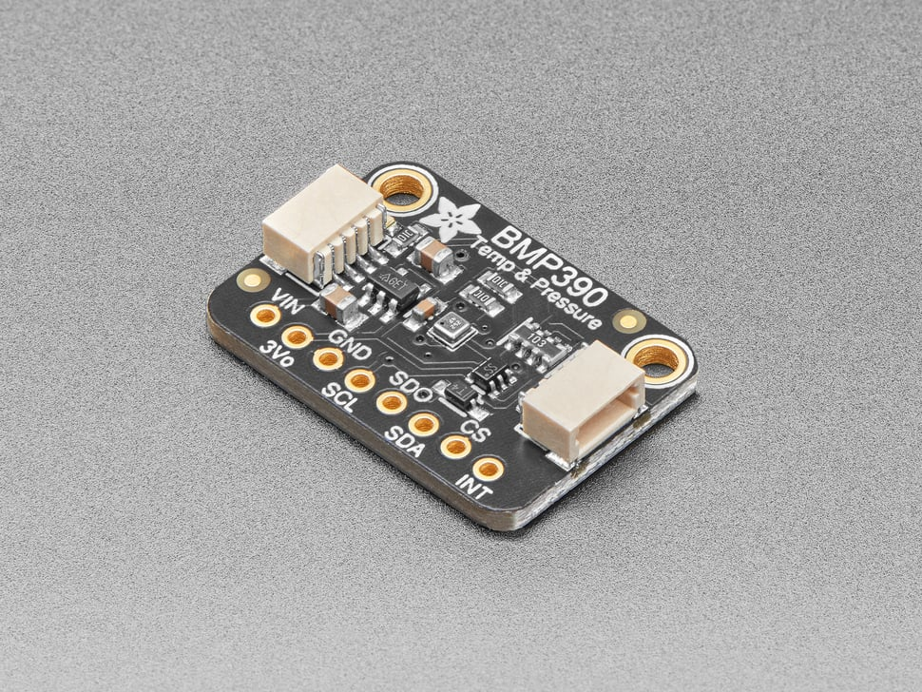
BMP388 / BMP390 Sensor
The BMP388 and BMP390 are high-precision digital barometric pressure sensors from Bosch Sensortec, part of the BMP3xx series, designed for accurate altitude tracking, weather monitoring, and drone stabilization. They measure absolute pressure and temperature using piezoresistive MEMS technology, with the BMP390 offering improved relative accuracy (±3 Pa vs. BMP388's ±8 Pa) for better altitude resolution (±0.25m vs. ±0.66m). Both are compact, low-power, and support I2C/SPI interfaces, making them ideal for Raspberry Pi integration.
Key Specifications (BMP388 / BMP390)
Pressure Range: 300 hPa to 1250 hPa (both)
Pressure Accuracy (Absolute): ±50 Pa / ±30 Pa (typical over 0–65°C)
Pressure Accuracy (Relative): ±8 Pa / ±3 Pa (equivalent to ±0.66m / ±0.25m altitude)
Pressure Resolution: 24-bit (down to 0.16 Pa / better in BMP390)
Temperature Range: -40°C to +85°C (both)
Temperature Accuracy: ±0.5°C typical (both)
Supply Voltage: 1.65V to 3.6V (both, 3.3V Pi-compatible)
Current Consumption: ~3.4 μA at 1 Hz (low-power mode)
Interface: I2C (up to 3.4 MHz) or SPI (up to 10 MHz)
FIFO Buffer: 512 bytes (for burst data, reduces host load)
Package: Tiny 2x2x0.75 mm LGA (on breakout boards for ease)
Adafruit BMP390 - Precision Barometric Pressure and Altimeter

Slide 25
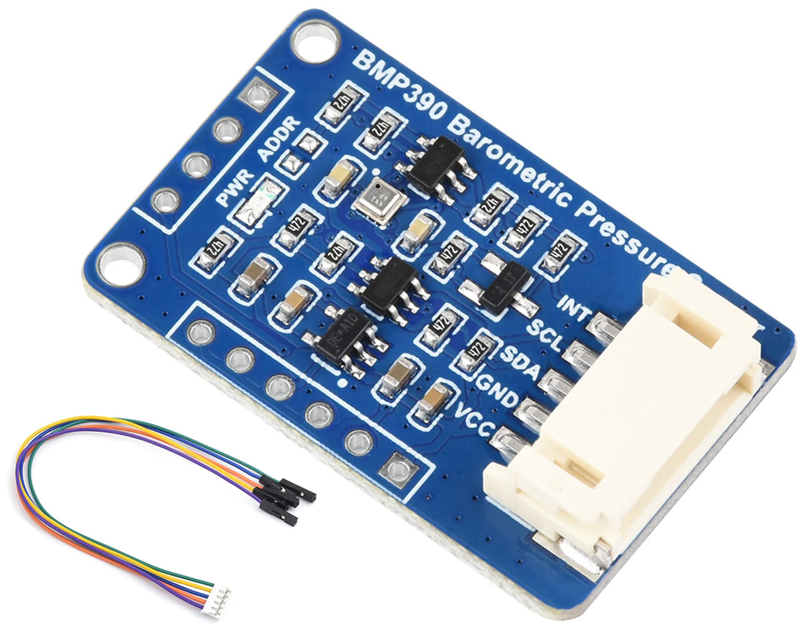
Connections to Raspberry Pi:
Available on breakout boards (e.g., Adafruit STEMMA QT / Qwiic or Waveshare), with standard 4–6 pin configuration for I2C (default, easiest):
VIN / VDD → 3.3V on Pi
GND → GND on Pi
SCL → GPIO 3 (SCL)
SDA → GPIO 2 (SDA)
Optional: INT (interrupt) → Any GPIO for data-ready alerts
For SPI: Add MOSI (GPIO 10), MISO (GPIO 9), SCLK (GPIO 11), CS (any GPIO)
BMP390 High Precision Barometric Pressure

Slide 26
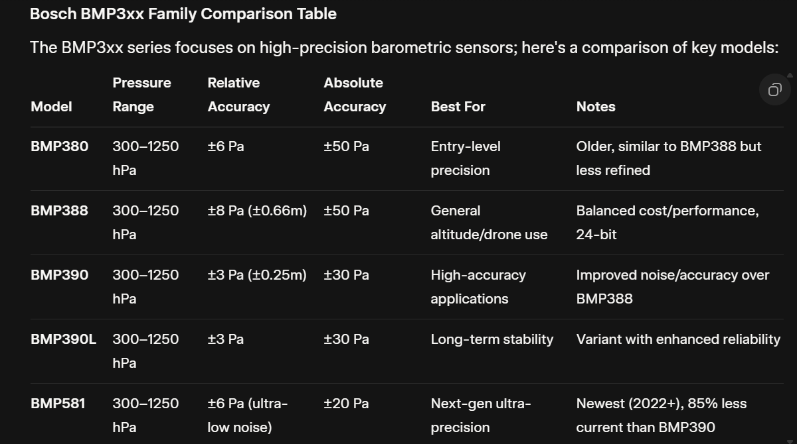

Slide 27
QMP6988 Sensor
The QMP6988 is a high-precision absolute barometric pressure sensor from QST Corporation, often used in M5Stack ENV III/IV units for environmental monitoring. It provides pressure and temperature data with excellent stability, suitable for altitude estimation, weather stations, and mobile applications, via an I2C interface for easy Raspberry Pi compatibility.
Key Specifications
Pressure Range: 30 kPa to 110 kPa (300–1100 hPa)
Pressure Accuracy (Relative): ±0.039 hPa (≈ ±1m altitude)
Pressure Resolution: High precision (down to 0.0002 hPa in some modes)
Absolute Accuracy: ±0.12 hPa typical
Temperature Range: -40°C to +80°C / +85°C
Temperature Accuracy: ±0.5°C typical
Temperature Resolution: 0.0002°C
Supply Voltage: 1.7V to 3.6V (3.3V Pi-compatible) or up to 5V in modules
Current Consumption: 21.4 μA average (low-power mode)
Interface: I2C (address 0x56)
Response Time: Fast, suitable for real-time
Package: Compact LGA (on M5Stack Unit breakouts)

Slide 28
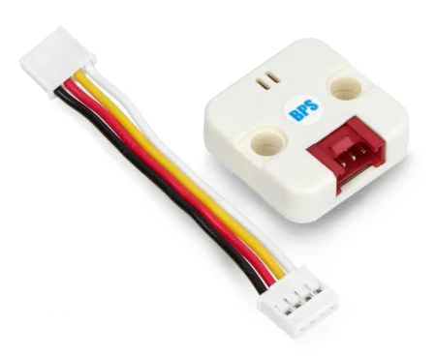
Principle
The QMP6988 employs a piezoresistive MEMS element to measure absolute pressure changes via resistance variations, integrated with a temperature sensor for compensation, delivering calibrated digital outputs over I2C with built-in filtering for stability.
Connections to Raspberry Pi
Typically on M5Stack Unit breakout (Grove-compatible) or generic boards with 4-pin I2C:
VCC / VIN → 3.3V or 5V on Pi (module-dependent)
GND → GND on Pi
SCL → GPIO 3 (SCL)
SDA → GPIO 2 (SDA)
Pressure sensor - barometer
- QMP6988

Slide 29
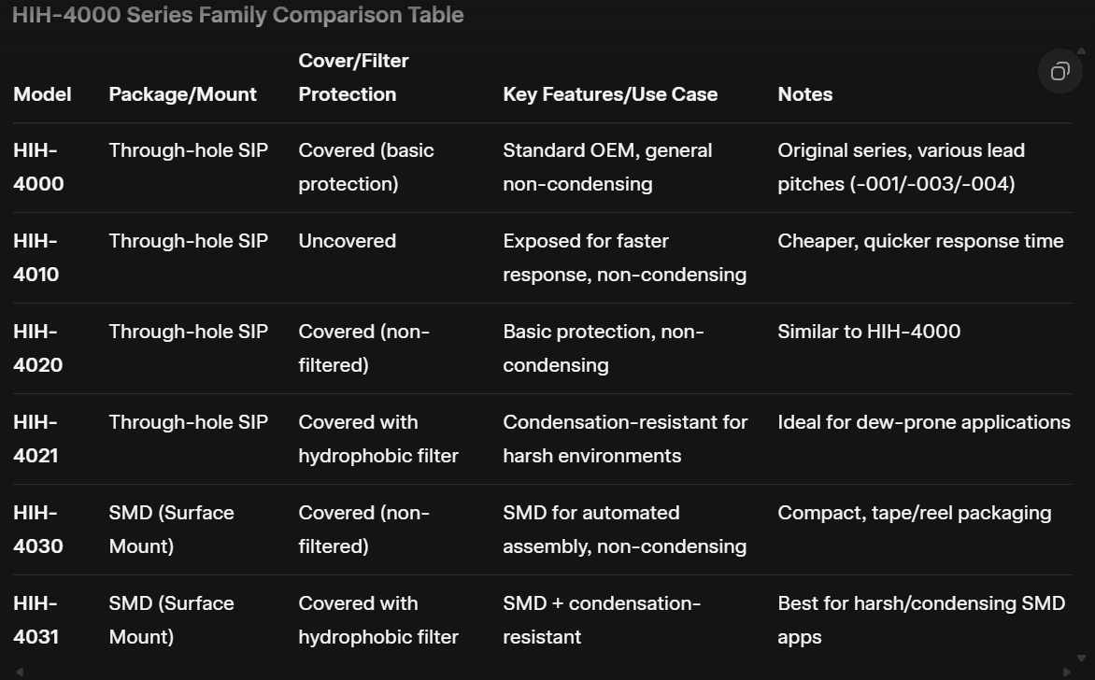

Slide 30
Gas & Air Quality Sensors: Monitoring Gases and Pollutants
Principle: Detect gases through chemical reactions (resistance change in MOX), infrared absorption (NDIR for CO2), or digital algorithms for VOCs/eCO2.
Types:
Analog Semiconductor (MQ Series) — Broad detection, heated oxide for multiple gases.
Digital VOC/eCO2 — MEMS-based for indoor quality.
NDIR CO2 — Optical, highly accurate true CO2.
Multi-Environmental — Combine gas with temp/humidity/pressure.
Key Specifications (General):
Gases: CO2 (400–5000ppm), TVOC, specific like NH3/smoke.
Accuracy: ±10–50ppm (CO2) or relative %.
Warm-up: Minutes for heated types.
Power: 3.3V–5V (higher for NDIR/heated).
Response Time: 10–60 seconds.
Interface: Analog (ADC needed), I2C, UART.
Examples for Raspberry Pi:
MQ-135 — Analog multi-gas (NH3, NOx, CO2, smoke). Sensitive to air quality changes; needs calibration and ADC.
MH-Z19B — NDIR true CO2 (0–5000ppm). Accuracy: ±50ppm +5%; UART interface, reliable for ventilation monitoring.
SCD41 — Precision NDIR CO2 (400–5000ppm) + temp/humidity. High accuracy (±40ppm +5%), I2C; excellent for accurate air quality

Slide 31
Gas & Air Quality Sensors (VOC, CO2, specific gases)
MQ-2 — Analog semiconductor sensor detecting smoke, LPG, methane, CO, and alcohol (needs ADC).
MQ-3 — Analog sensor specialized for alcohol and ethanol detection.
MQ-4 — Analog sensor for methane and natural gas detection.
MQ-5 — Analog sensor sensitive to LPG and natural gas.
MQ-6 — Analog sensor for LPG and butane.
MQ-7 — Analog carbon monoxide-specific sensor.
MQ-8 — Analog hydrogen gas detector.
MQ-9 — Analog sensor for CO and flammable gases.
MQ-131 — Analog ozone detection sensor.
MQ-135 — Broad analog multi-gas sensor for NH3, NOx, benzene, CO2, and smoke.
MQ-136 — Analog hydrogen sulfide detector.
MQ-137 — Analog ammonia sensor.
MQ-138 — Analog VOC sensor for toluene, acetone, and similar compounds.
MQ-214 — Analog methane and natural gas sensor variant.
CCS811 — Digital I2C sensor for eCO2 and TVOC indoor air quality.
SGP30 — Sensirion digital I2C sensor for VOC and equivalent CO2.
MICS6814 — Multi-gas analog sensor detecting CO, NO2, and NH3 in one module.

Slide 32
MQ Series Gas Sensors
The MQ series consists of low-cost analog metal oxide semiconductor (MOS) gas sensors (primarily SnO₂-based) that detect various gases through changes in resistance when exposed to target gases. A built-in heater (~5V, 120–180mA, ~0.8W power) maintains operating temperature, causing the sensor to warm up. They offer analog output (voltage proportional to gas concentration) and often digital (threshold via potentiometer on modules). Detection requires calibration (using sensitivity curves from datasheets), as they are cross-sensitive (respond to multiple gases) and affected by temperature/humidity.Typical detection range: 100–10,000 ppm (varies by model).
General Specifications (Common Across Most MQ Series):
Operating Voltage: 5V ±0.1V (heater and circuit)
Heater Power Consumption: ~800mW (120–180mA)
Output: Analog (0–5V voltage) + Digital (HIGH/LOW threshold)
Interface: Analog (needs ADC on Raspberry Pi, e.g., MCP3008) or digital pin
Preheat Time: 24–48 hours initial, ~1–5 minutes per use
Response/Recovery Time: <10–30 seconds typical
Lifespan: 2–5 years (depending on environment)
Sensitivity: High to primary gas, cross-sensitive to others
Working Temperature: -10°C to +50°C typical

Slide 33
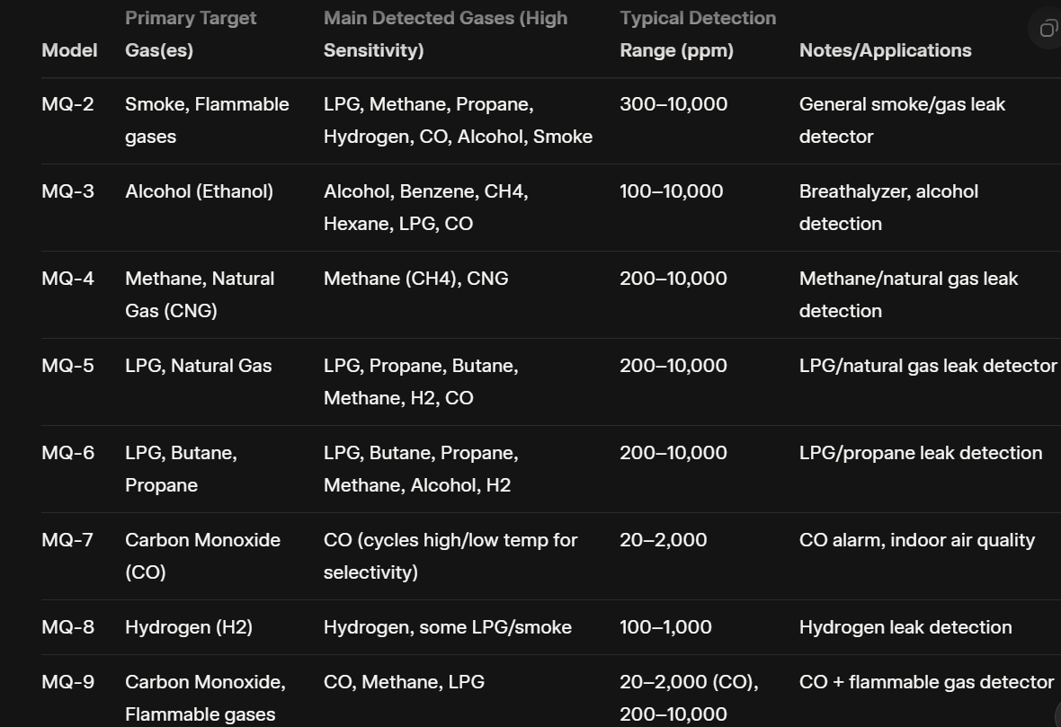

Slide 34
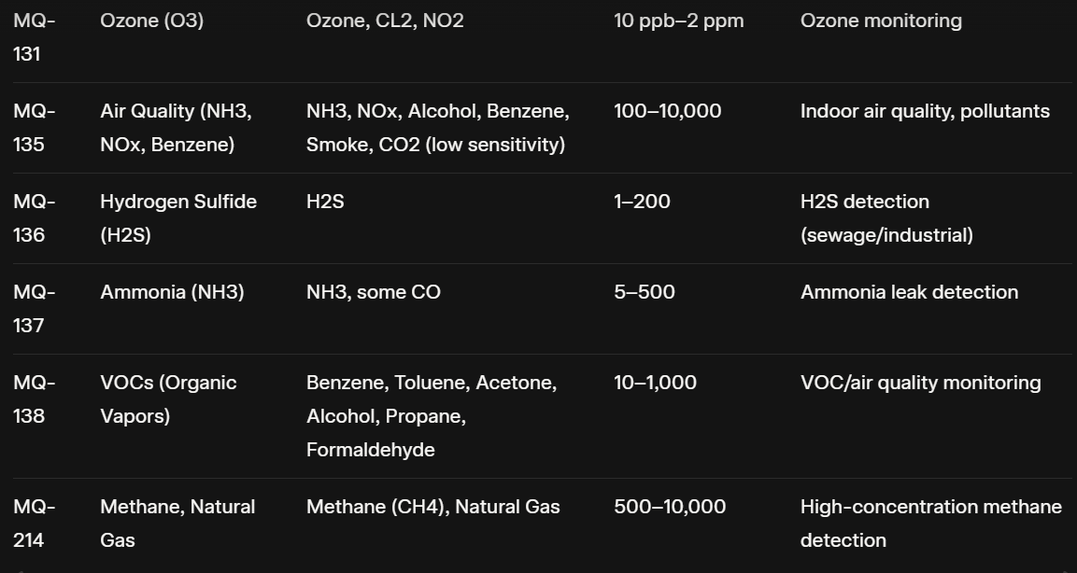

Slide 35
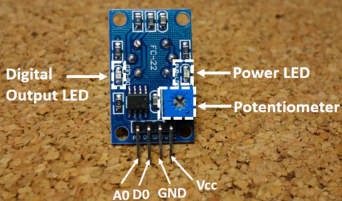
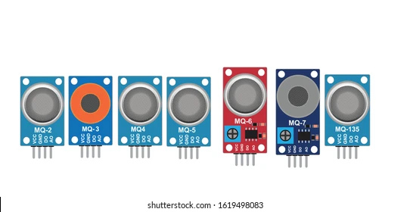
MQ-135 air quality breakout.
Common MQ sensor types overview.

Slide 36
Multi-Environmental Sensors (temp + humidity + pressure + gas/CO2/PM)
BME680 — Bosch all-in-one I2C sensor for temp, humidity, pressure, and VOC gas (air quality index).
BME688 / BME690 — Advanced Bosch sensors with AI-capable gas detection for specific pollutant identification.
SCD-40 / SCD-41 — Sensirion photoacoustic NDIR CO2 sensors with integrated temp and humidity (±40ppm CO2 accuracy).
ENV III Unit — M5Stack combo unit with SHT30 humidity/temp and QMP6988 pressure.
ENV IV Unit — M5Stack unit combining SHT40 humidity/temp with BMP280 pressure.

Slide 37
CO2 & Particulate Matter (PM) Sensors (key for full air quality)
MH-Z19 — NDIR infrared CO2 sensor (0-5000ppm) with UART interface, popular for accurate readings.
PMS5003 / PMSA003 — Laser-based particulate matter sensors for PM2.5 and PM10.
SDS011 — Reliable laser PM2.5/PM10 sensor, commonly used outdoors.
SPS30 — High-accuracy Sensirion PM sensor for PM1/2.5/4/10 with fan.
SCD30 — Sensirion NDIR CO2 sensor with temp/humidity integration.
ICP-10125 — High-accuracy absolute pressure sensor for precise barometric readings.
TGS4161 — Voltage-probe solid electrolyte CO2 sensor for specific applications.

Slide 38
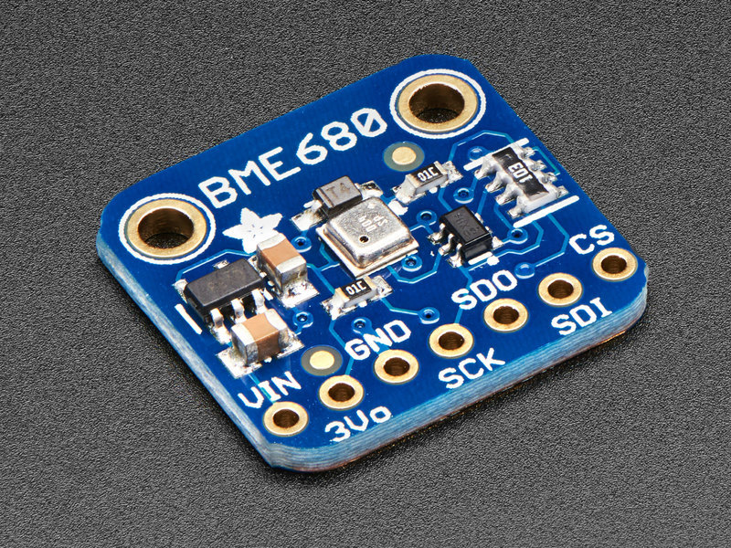
Connections to Raspberry Pi
Standard breakout (e.g., Adafruit STEMMA QT):
VIN → 3.3V, GND → GND,
SCL → GPIO 3,
SDA → GPIO 2 (I2C).
Enable I2C via raspi-config; libraries like Adafruit_BME680 or Bosch BSEC.
Key Specifications:
Temperature: -40°C to +85°C, ±0.5°C typical accuracy, 0.01°C resolution
Humidity: 0–100% RH, ±3% accuracy, 0.008% resolution
Pressure: 300–1100 hPa, ±0.6 hPa absolute accuracy, ~0.5m altitude resolution
Gas (VOC): Resistance 10–1000 kΩ (for IAQ calculation), detects reducing/sensitizing gases
Supply Voltage: 1.71V to 3.6V (3.3V typical for Pi)
Current: ~3.7 μA (low-power mode), up to 12 mA during gas heating
Interface: I2C (default, address 0x76/0x77) or SPI
Features: Built-in heater for gas, IAQ index via Bosch BSEC library

Slide 39
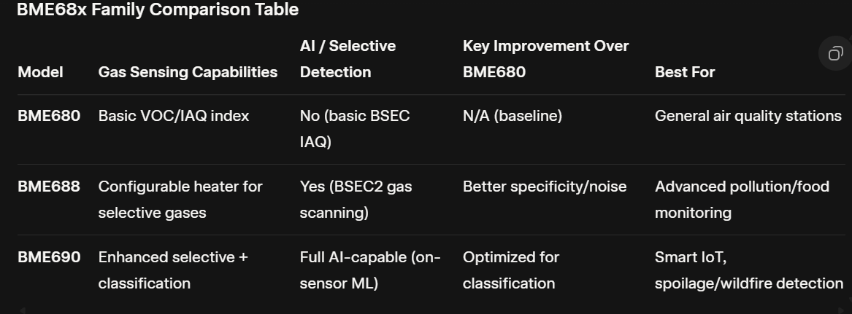

Slide 40

THANK YOU!

